Slide 1
Vision
Dr.Ghadeer Hamad

Slide 2
Visual acuity
Visual acuity (VA) is the ability to see the details and contours of objects clearly. It is tested for both distant as well as near vision.

Slide 3
TEST FOR DISTANT VISION
Snellen’s chart or Snellen’s types
The distant vision is clinically tested with this chart. It has a series of printed letters of varying sizes, black on a white background, arranged in eight lines. The top letter, the largest, is visible to the naked eye at a distance of 60 meters, and the subsequent letters at distances of 36, 24, 18, 12, 9, 6 and 5 meters respectively. The distances for each line are indicated above it (or below it in some charts).

Slide 5
Testing the Distant Visual Acuity
1.The subject is seated at a distance of 6 meters (20 feet) from a well-lighted chart and is asked to read the letters down the chart as far as she can read. Each eye is tested separately.
2. The VA is recorded according to the formula VA = d/D where d is the distance at which the letters are read, and D is the distance at which the letter should be read by a person with normal vision.
3. Thus if only the top letter can be read, the VA is 6/60. If the subject can read only the first 4 lines, then the VA is 6/18, and so on. A normal person should be able to read at least the 7th line, i.e. have a VA of 6/6 (20/20 in terms of feet, commonly pronounced “twenty-twenty” vision.)
4. If the VA is less than 6/60, the subject is moved towards the chart until she can read the top letter. The VA is 2/60 if she can read it at 2 meters. The VA less than 1/60 is recorded as “counting fingers” (CF; if she correctly counts fingers when held in front of her face; “hand movements” (HM);

Slide 6
Color Vision
The human eye is sensitive to all wavelengths of light from 400 nm to 700 nm which constitute the visible part of the electromagnetic spectrum. Colors are perceived by cones that are concentrated in fovea and are sensitive to specific wavelengths of light.
.There are three primary Colors – red, green, and blue.. For every color, there is a complementary color that when properly mixed with it, produces a sensation of white.

Slide 7
Color vision
The sensation of white, any spectral color, and even extra-spectral color (e.g. purple) can be produced by mixing various proportions of primary colors. (The paints used in painting are not pure colors but mixtures of different pigments)
Black is the sensation caused by absence of light. It is probably a positive sensation, because the blind eye does not “see black”, it “sees nothing”. Finally, the color perceived depends on the color of other objects in the visual field.

Slide 8
TESTING OF COLOR VISION
Mechanism of Color Vision???
Factors affecting visual acuity??
I. Ishihara charts.

Slide 9
Procedure
Procedure
1. Seat the subject in a room adequately lit by day light. Direct sunlight or electric light may cause discrepancies in the result due to changes in the shades of the colors.
2. Ask the subject to read the numbers or trace the wavy lines on successive plates. The correct answers are given at the back of the book to exclude the possibility of examiner being color blind. For example, the person with normal color vision will read plate 3 in Figure as 5, while a person with defective color vision will reads it as 2. The results with other plates are given in Table.

Slide 11
Result of Ishihara test
Plate | Person with normal | Person with red-green deficiency | Person with total color blindness
1 | 12 | 12 | 12
2 | 29 | 70 | X
3 | 5 | 2 | X
4 | 6 | X | X
5 | 7 | X | X
6 | x | 5 | x

Slide 12
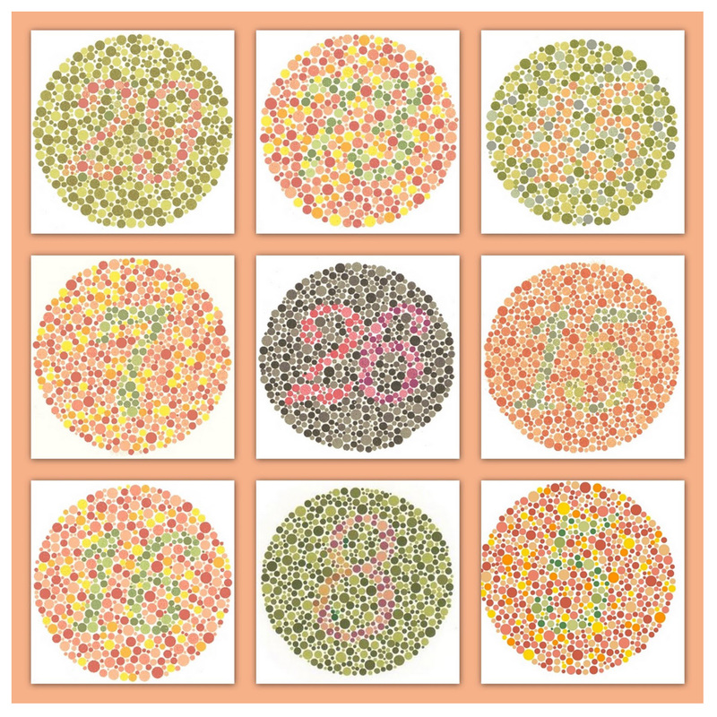

Slide 13
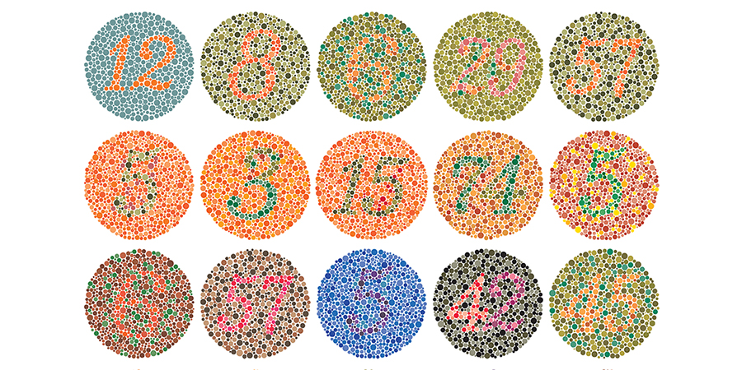

Slide 14


